Slide 1
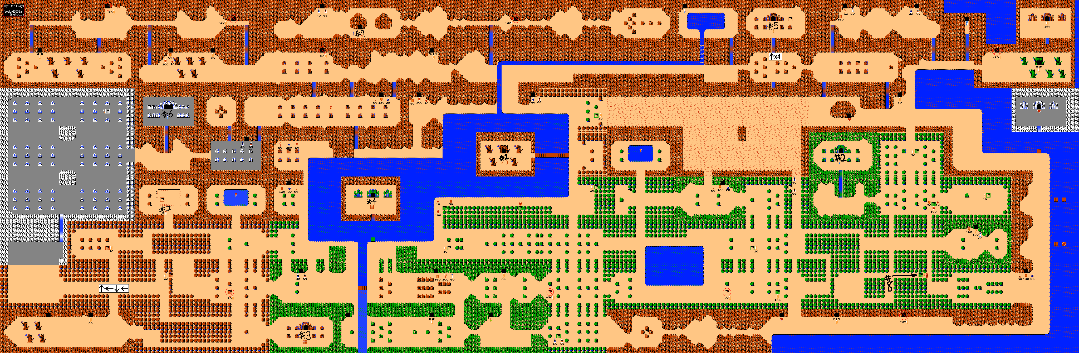



CSE 380 – Computer Game Programming
Tile Based Graphics
& Scrolling
Legend of Zelda, by Nintendo, released 1987

Slide 2
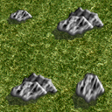



What is a tile (generally speaking)?
A building block of a game board
Piece together tiles to create a world
Why use tiles?
  to conserve memory
  graphics reuse
  dynamic content

Slide 3
Are there any other background alternatives?
Large background images
  can provide rich, full detail
Combination of large images and tiling

Slide 4
A memory comparison
Ex: Warcraft III map (assume 32-bit color, 4 byte/pixel)
  6,400 pixels x 6,400 pixels
  Option 1: Large Background Image (no tiles)
    Memory requirements: a single image
      6,400 x 6,400 x 4 bytes/pixel = 163,840,000 bytes
  Option 2: 100 tile set
    each tile: 64 pixels x 64 pixels = 4,096 pixels per tile
    map layout: 100 tiles x 100 tiles = 10,000 tiles
    Memory requirements
      a tile engine to store the 100 tiles
        100 tiles x 4,096 pixels/tile x 4 bytes/pixel = 1,638,400 bytes
      An array to specify where tiles are to be placed
        10,000 tiles x 1 byte per tile = 10,000 bytes
      Total memory usage = 1,638,300 + 10,000 bytes = 1,648,300 bytes

Slide 5
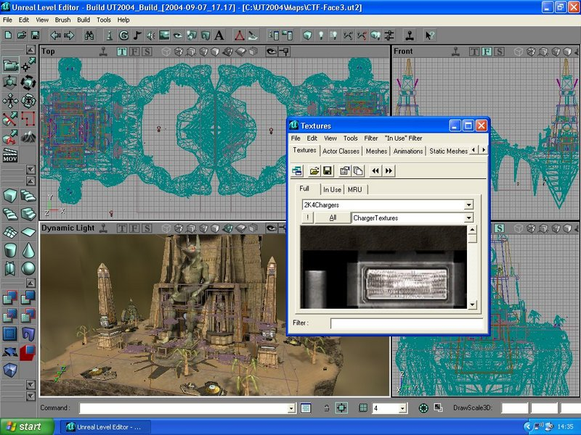
Why else is graphics reuse important?
Because artist time is expensive
Level designers can layout a map

Slide 6
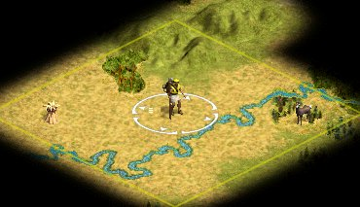
How can tiles be dynamic?
Random map generator
  adds to game re-playability
  a different game each time you play it

Slide 7




Identify tiles needed
Terrain
  grass, dirt, sand, snow, water, mountains, etc.
Walls
Roads
Buildings
etc.
And don’t forget terrain borders. What’s that?

Slide 8
Layout Level Map
Generate a map file to describe layout
What format? Many used
  tools like MapMaker just for this purpose
Criteria for format:
  easy to edit by a non-programmer (i.e. level designer)
  easy to read in and use by game program
One option: use a CSV file. What’s CSV?
  comma separated value
How?
  denote a tile number or tile string in each cell
Alternative: create a level design program
  a GUI to graphically pick & place tiles

Slide 9
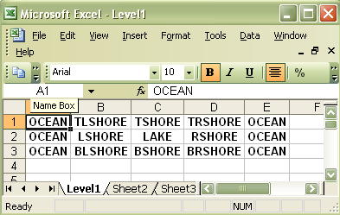








Map Editing Example (3x5 world)
Map drawn using a 10 piece tile set
  T refers to top, B refers to bottom
  L refers to left, R refers to left
  Ex: TSHORE refers to top shore
  Ex: BRSHORE refers to bottom right shore

Slide 10
What is a tile (practically speaking)?
An image
Can be created by Paint, Photoshop, etc.
Decide on tile size, which depends on:
  size of map
  memory restrictions
Common to use powers of 2:
  2⁵ = 32
  2⁶ = 64
  2⁷ = 128
Danger: a map with many different large tiles

Slide 11
What are Textures?
Used for tiling games elements
  backgrounds, sprites, and 3D models
DirectX has a class for storing textures:
  LPDIRECT3DTEXTURE9
Provides fast access to image data
Common file types:
  .tga, .dds
  image files can be converted by Texture Tool

Slide 12
Image vs. Texture Files
What’s the advantage to keeping tiles in image files?
  artists can tweak images
  good during game development stage
What’s the advantage to converting tiles from image files to texture files (.tga or .dds)?
  speed of execution (loading levels)
  good after game has been deployed

Slide 13



Color Key
Color to represent transparency
  when a tile or sprite is drawn, pixels with the color key are ignored
  Why?
    because those pixels should not be drawn
Specify this precise shade of blue as color key when:
reading file
drawing object

Slide 14


Multi-layering Tiles
Most worlds require layering. Ex:
  place grass
  place flowers on grass
  place cloud over flowers
Other common objects:
  trees
  rocks
  treasure
To edit:
  use multiple CSV files, one for each layer
  map file may join & order CSV files

Slide 15
How should we manage our layers?
Different types of layers:
  TiledLayer
  SparseLayer
  IsometricLayer (we’ll see this later this semester)
We can layer them on top of one another, ex:
  TiledLayer first, then SparseLayer

Slide 16
TiledLayer
Background is wall-to-wall tiles
Images loaded into texture manager
Each image gets an id, layout using ids
Ex:
0,1,2,3,0,0,1,2
0,1,2,3,0,0,1,2
0,1,2,3,0,0,1,2
0,1,2,3,0,0,1,2
etc.

Slide 17
Implementing TiledLayer
A 2D grid of Tiles
class TiledLayer: public WorldLayer
{
protected:
vector<Tile*> *tileLayout;
int columns;
int rows;
int tileWidth;
int tileHeight;
int layerWidth;
int layerHeight;
int z;
struct Tile
{
int textureID;
bool collidable;
};

Slide 18
Rendering via render list
Again, only render that which is visible
More on this when we talk about scrolling

Slide 19
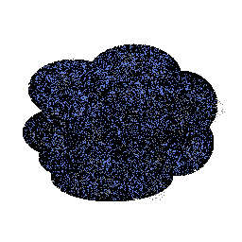
SparseLayer
Tiles (overlay images) here and there
Spaces in between
Tiles of various sizes

Slide 20
Implementing SparseLayer
struct OverlayImage
{
int imageID; // INDEX OF IMAGE IN TEXTURE MANAGER
int x; // X LOCATION
int y; // Y LOCATION
int z; // Z LAYER
int alpha; // TRANSPARENCY
int width; // TEXTURE WIDTH TO USE
int height; // TEXTURE HEIGHT TO USE
};
class SparseLayer : public WorldLayer
{
private:
vector<OverlayImage*> *sparseTiles;
…

Slide 21
So how do we render our world?
Depends on what we are viewing
  game world scrolls
Each frame:
  add visible tiles to level render list
  render contents or render list like any other texture

Slide 22
Game World
A large virtual area
Typically broken up into “levels” or “maps”
Warcraft III maps: 6400 pixels X 6400 pixels
While playing we:
  only see a small portion
  view the game through a “viewport”
    a window on the game

Slide 23
Viewport
Game World
Viewport

Slide 24
Moving the Viewport
You must keep track of where in your world your viewport is. Ex:
int viewportX, viewportY;
  to scroll the game:
    update viewportX & viewportY each frame
    figure out what’s inside the viewport
    render those things relative to the viewport
Don’t let viewportX become:
  negative
  more than World Width – Viewport Width
Don’t let viewportY become:
  negative
  more than World Height – Viewport Height

Slide 25
Naïve Approach
Move viewport precisely as player moves
if (input->isKeyDown(W_KEY))
{
vY = -PLAYER_SPEED;
viewport.setY(viewport.getY()
-PLAYER_SPEED);
}
What’s wrong with this?

Slide 26
When should we update the viewport?
Right before rendering. After:
  Getting and processing user input
  Ai
  Physics
Why?
  They may affect player position
Scope viewport right before rendering

Slide 27
Scoping the Viewport
How?
  Depends on game genre
  Ex: RTS may be independent of units
Side-Scroller Goals:
  follow the player
  don’t let player out of viewport
  make sure player sees important game objects
  avoid a jittery viewport
  scroll smoothly

Slide 28
Side-Scroller Viewport Strategy
Offline:
  determine target player location relative to viewport
Each frame:
  update viewport speed to smoothly catch up with target
    use gradually accelerating (up & down) viewport for even better look
  update viewport location using speed
    and speed using acceleration

Slide 29

Targeting the Viewport

Slide 30
Our Viewport class
class Viewport
{
private:
int scrollSpeedX;
int scrollSpeedY;
int viewportX;
int viewportY;
int viewportWidth;
int viewportHeight;
int viewportOffsetX;
int viewportOffsetY;
NOTE: You may also choose to add a viewport target and acceleration

Slide 31
Visible Tiles
Each frame, most tiles are not visible
  so don’t try to draw them
So, each frame:
  for each layer:
    test for visible tiles
    add only those tiles to render list
How should we test tiles for a tiled layer?
How should we test tiles for sparse layer?

Slide 32
Which TiledLayer tiles are visible?
What’s the visible left tile column?
  viewportX / tileWidth
What’s the visible right tile column?
  (viewportX + Viewport Width) / tileWidth
What’s the visible top tile row?
  viewportY / tileHeight
What’s the visible bottom tile row?
  (viewportY + Viewport Height) / tileHeight

Slide 33
Where do you draw the tiles?
We specify tiles in tile coordinates
Suppose a tile is at location 2, 1 (column, row)
If tiles are 64 pixels wide, in world coordinates:
  64*2, 64*1 = (128, 64)
If a tile is deemed visible, draw it at:
  Tile’s world coordinatesX-viewportX,
  tile’s world coordinatesY-viewportY
So, if the viewport is at 32, 32, draw the tile at:
  (96, 32)

Slide 34
You with me?

Slide 35


What about clipping?
We may end up with visible tiles partially outside the viewport
We should draw portions of those textures visible

Slide 36
How about SparseLayer tiles?
We have to check them one by one
How can we test if a sparse tile (OverlayImage) is in the viewport?
bool Viewport::areViewportCoordinatesInViewport(
int x, int y, int width, int height)

Slide 37
bool Viewport::areViewportCoordinatesInViewport(
int x, int y, int width, int height)
{
// IS IT OFF-SCREEN TO THE LEFT OF THE VIEWPORT?
if ((x + width) <= 0)
return false;
// IS IT OFF-SCREEN ABOVE THE VIEWPORT?
else if ((y + height) <= 0)
return false;
// IS IT OFF-SCREEN TO THE RIGHT OF THE VIEWPORT?
else if (x >= viewportWidth)
return false;
// IS IT OFF-SCREEN BELOW THE VIEWPORT?
else if (y >= viewportHeight)
return false;
// IT MUST BE AT LEAST PARTIALLY IN THE VIEWPORT
else
return true;
}

Slide 38
Parallax Scrolling
When background moves across screen at a slower pace than objects in foreground (like player)
Why do this?
  to give the illusion of distance
How can we do this?
  make parallax layer smaller than other layers
  scroll parallax layer slower than other layers proportionally to size difference

Slide 39
Scrolling & the Player
Let’s rethink scrolling
Player also likes to see where he/she is going
If player is looking/running right:
  scroll right until player is in left 1/3 of viewport
If player is looking/running left
  scroll left until player is in right 1/3 of viewport

